Slide 1


BWISE WMS Connector v1.0
Technical and functional documentation

Slide 2





BWISE WMS Connector
Integration Components
SAP
Business One
SAP
Service Layer
WISE
Batch Scheduler
WISE
Universal Adapter
Royal 4
WISE

Slide 3


BWISE WMS Connector
Solution Architecture Diagram
WISE Universal Adapter
WISE Batch Scheduler
SAP Service Layer
SQL & HANA

Slide 4
Data Flow From B1 to WISE
Master Data (In)
Business Partners (Customer, Vendors)
Transactions (In)
Sales Orders
Purchase Orders
Items
UOM
Return Requests
Good Return Requests

Slide 5
Data Flow From WISE to B1
Transactions (Out)
Receipt Confirmation
Sales Returns Confirmation
Purchase Returns Confirmation
Shipment Confirmation
Pick Lists
Inventory Adjustments/Counts

Slide 6
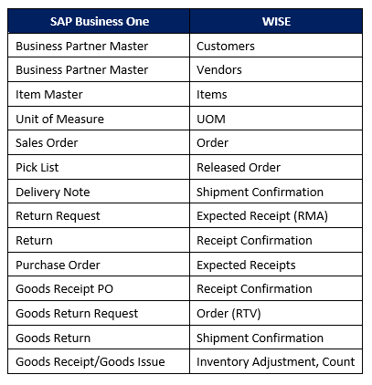
xReference Table

Slide 7
Business Partners – Integration Points
Customers
Ship To’s
Business Partners
SAP
Service Layer
WISE
Batch Scheduler
WISE
Universal Adapter
Vendors

Slide 8
Items – Integration Points
Items
Items
UOMs
SAP
Service Layer
WISE
Batch Scheduler
WISE
Universal Adapter

Slide 9
Sales Orders – Integration Points
Sales Orders
Orders
SAP
Service Layer
WISE
Batch Scheduler
WISE
Universal Adapter

Slide 10
Pick Lists – Integration Points
Pick List
Released Orders
SAP
Service Layer
WISE
Batch Scheduler
WISE
Universal Adapter

Slide 11
Delivery Notes – Integration Points
Delivery Notes
Shipped Orders
SAP
Service Layer
WISE
Batch Scheduler
WISE
Universal Adapter

Slide 12
Return Requests – Integration Points
Return Requests
Expected Receipt
SAP
Service Layer
WISE
Batch Scheduler
WISE
Universal Adapter

Slide 13
Returns – Integration Points
Returns
Received Expected Receipt
SAP
Service Layer
WISE
Batch Scheduler
WISE
Universal Adapter

Slide 14
Purchase Orders – Integration Points
Purchase Orders
Expected Receipt
SAP
Service Layer
WISE
Batch Scheduler
WISE
Universal Adapter

Slide 15
Goods Receipt PO – Integration Points
Good Receipt PO
Received Expected Receipts
SAP
Service Layer
WISE
Batch Scheduler
WISE
Universal Adapter

Slide 16
Goods Return Requests – Integration Points
Goods Return Requests
Orders
SAP
Service Layer
WISE
Batch Scheduler
WISE
Universal Adapter

Slide 17
Goods Returns – Integration Points
Goods Returns
Shipped Order
SAP
Service Layer
WISE
Batch Scheduler
WISE
Universal Adapter

Slide 18
Inventory Transactions – Integration Points
Goods Receipt
Inventory Adjustments
Goods Issue
SAP
Service Layer
WISE
Batch Scheduler
WISE
Universal Adapter
Physical and Cycle Counts

Slide 19
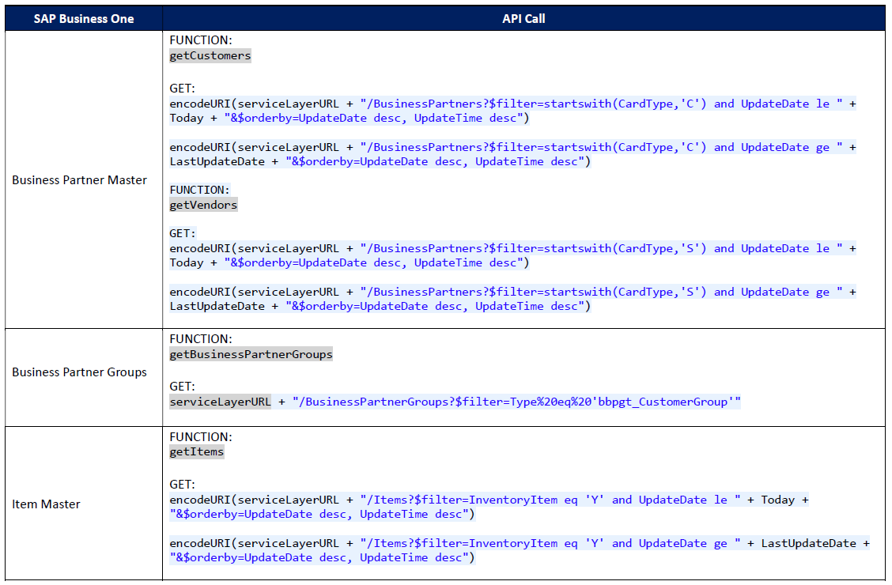
Service Layer – API Calls

Slide 20
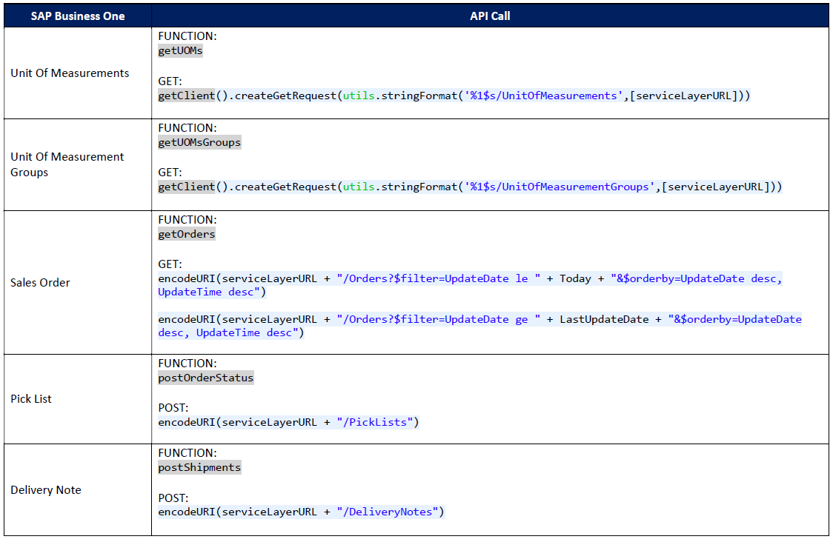
Service Layer – API Calls

Slide 21
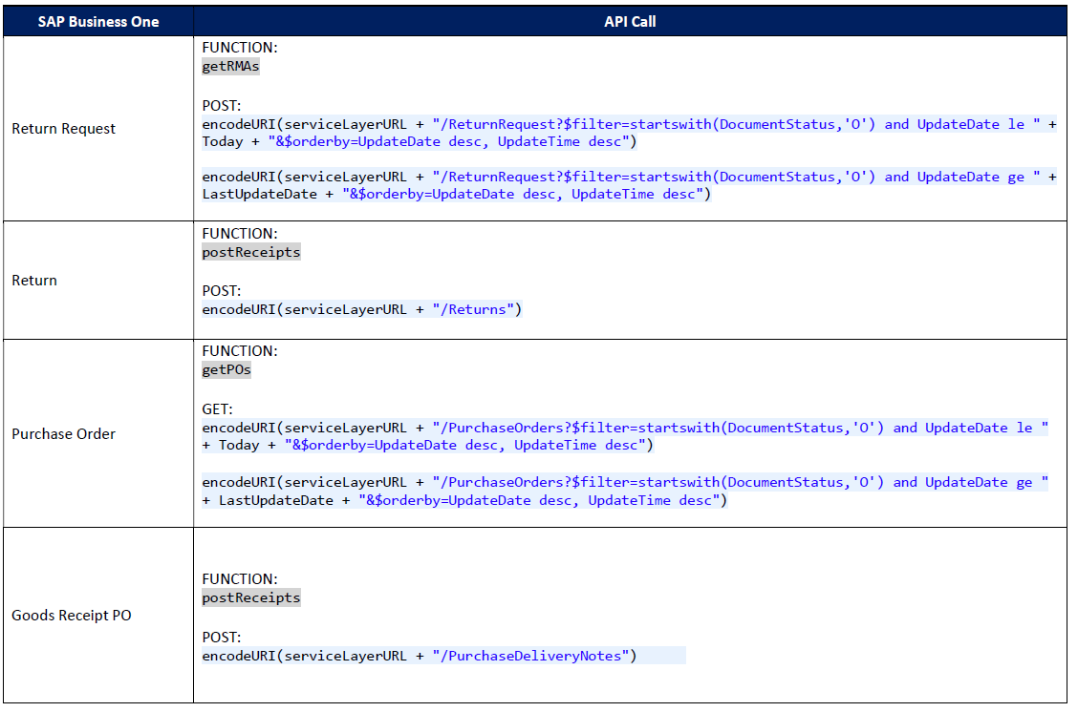
Service Layer – API Calls

Slide 22
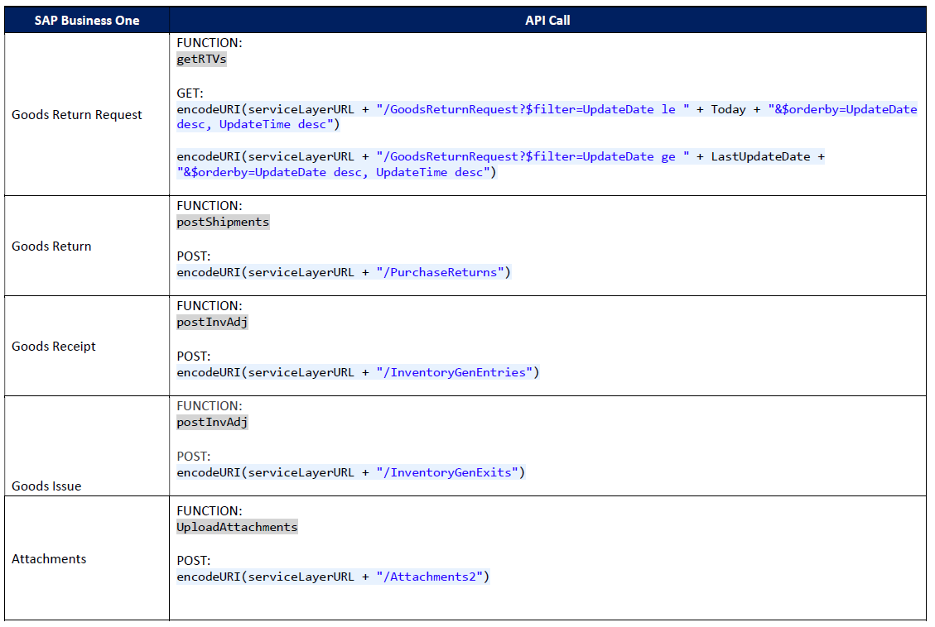
Service Layer – API Calls

Slide 23
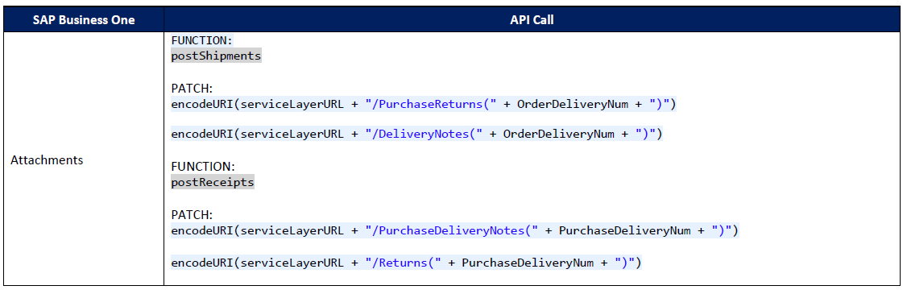
Service Layer – API Calls

