Slide 1


BWISE Solutions - WISE WMS
Channel Partner Onboarding - Sales

Slide 2


Channel Partner Onboarding – Sales - Agenda
Day One
  Solution Introduction
  WISE
  3PL
  Yard
  Connector
  Discovery
  Scoping and Pricing
Day Two
  Product Overview
Day Three
  Test
  Q&A

Slide 3
BWISE Solutions
WISE – Gartner Mid-Market Notable for WMS
SAP – Value Added Reseller (VAR) and Software Solutions Partner (SSP)
Headquartered: Long Beach, California
Offices in: Mexico, Columbia, Spain, the Netherlands, Romania
Used in 14 countries
Founded: 1984
110+ employees
300+ WISE customers
2 customers – 37+ years
24 customers – 25+years
Tier 1 Competitors include – RT, Manhattan, Korber
Highjump, SAP S/4 EWM and advanced EWM
SAP competitors include – Produmex, LISA, Computec,
Resolve WMS, Wysis

Slide 4

Why BWISE
Lower Total Cost of Ownership than many other WMS solutions
Faster to install, implement
Set up is less complicated than other WMS solutions
Easier to implement than other WMS Solutions opening the market to smaller opportunities
Built in interfaces to industry standard tools – ie. Bartender or Shipstation
No need to conform to EU standards if not in the EU
Picking processes are more efficient, no need for the Picklist proposal
No need for a scaled version for smaller companies
More robust than other solutions including;
  Yard Management
  Dock Scheduling
  Cross Docking
  Drop Ship
  Directed Put-away
  3PL/4PL Support
  Advanced Voice-Picking
  Real-time and fully secure Customer Portal
Proven Tier One implementations
A certified SAP Software Solutions Provider (SSP)

Slide 5
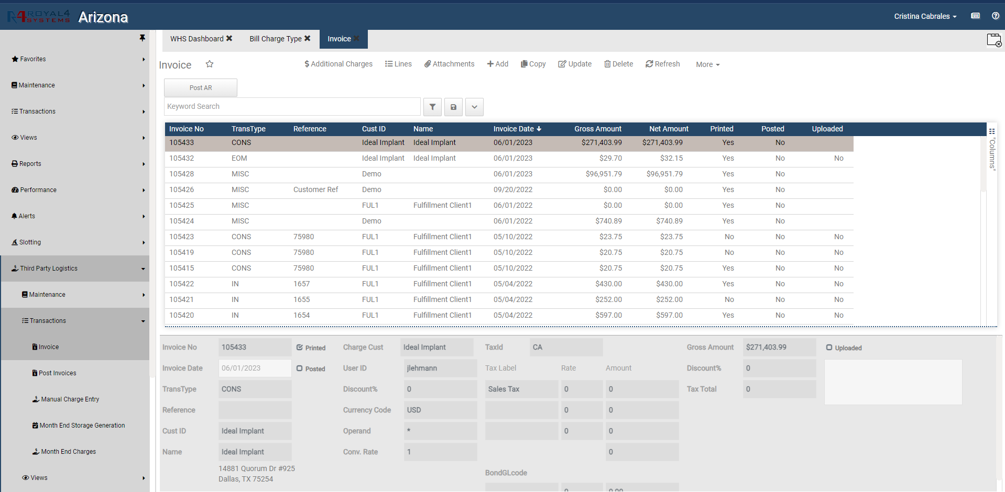

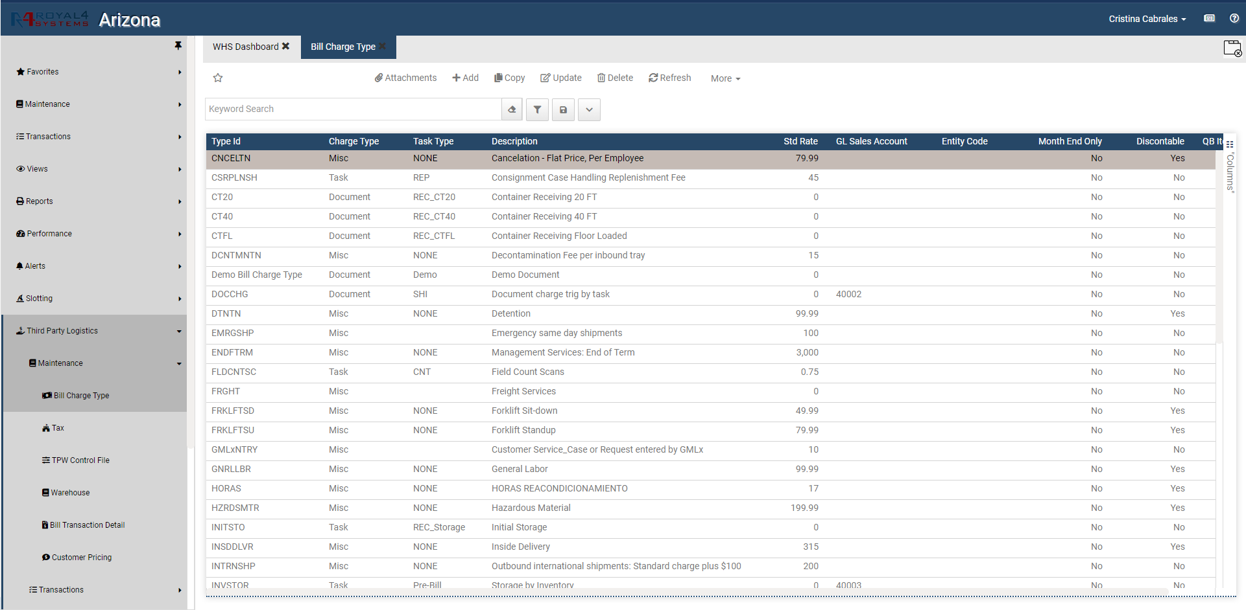
WISE – Warehouse Management and Distribution
Not one-size fits all
Enabled:
BWISE – fully integrated SAP Business One and WISE WMS for a truly world class end-to-end solution WISE WMS – world class Tier 1 functionality for Small-to-Midsize Business – integrates with any modern ERP WISE-3PL – a tailored solution for specialized needs in services and transaction tolling WISEmove – a tailored solution for specific requirements for Moving-Storing-Transiting companies

Slide 6

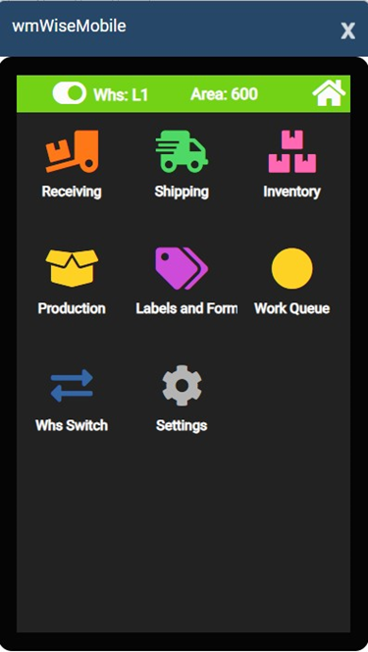
Enable your Warehouse with Mobile Apps
Access real time data from your mobile devices
Mobile Apps
Enabled:
WISEmobile – mobility for inventory movement, labelling, cycle counting WISEvoice – voice-enabled picking WISE-els – optimized picking efficiency and time standards

Slide 7

WISE 3PL/4PL – Third- and Fourth-Party Logistics
Not one-size fits all
Benefits: Automated data collection from WMS activities to generate automated invoicing Billing for WMS activities such as receiving, shipping, kitting Capture such VAS as repackaging, shrink-wrapping, breakdown, assortment Multiple options to define specific billing rates
Default price list, customer specific pricing Repacking rates based on yield percentage
Benefits: Daily, weekly, bi-monthly, quarterly, and yearly invoicing Custom services capabilities and associated billing Flat monthly rates for storage

Slide 8

WISE 3PL/4PL – Third- and Fourth-Party Logistics
Not one-size fits all
Key Features:
Integration to mainstream ERP solutions: SAP Business One (certified), SAP S/4, Oracle, NetSuite, Epicor, Infor, MS Dynamics, Sage, QAD and more eWISE Customer Portal for on-line real-time access to their current situation Accurate, real-time inventory visibility to accelerate inventory and maximize fill order fill rates WISE 3PL tracks all value add functions and associated billing Split month storage, full month, partial month, etc… Space utilization (space, locations)
Key Features: Transaction by volume, by task, by unit of measure, total number of transactions Billing for kitting, work orders, office services, labor, materials, repackaging, etc… Unlimited user defined billing scenarios Capture and provide daily, weekly, monthly and yearly VAS invoicing

Slide 9
Why BWISE – Yard Management - YMS
Dock Scheduling
Web Application for appointment setting
Gate check in/out
Driver check in/out
SMS texting
Trailer locating - with “drag and drop”
Demurrage Control
Document Management - pictures/video
Yard locations
Integrate with WMS/Invent - in/out
eSign BOL
Multi-warehouse
Task/move management
Driver web application
Analytics, reporting
Dashboards, alerts

Slide 10


WISE Solutions Deployment Options
On premise and Cloud
On premise
Cloud
Key Benefits
Compliance with internal Data Security Policies Direct control and access to your data, allowing flexibility in local reporting accesses Better ability to customize and extend your business process Leverage internal hardware and existing IT infrastructure and resources Perpetual licensing, with higher upfront cost but better long-term TCO Less dependence on always-connected internet
Key Benefits
Easy and affordable deployment Secure browser-based access from anywhere, at any time Access to the most up-to-date functionality without having to use rely on in-house IT resources to maintain the solution Subscription licensing avoiding capital expenditure and allowing for operational expenditure flexibility Manage your most critical business functions in your Web browser.

Slide 11






BWISE – end-to-end, fully integrated
Financials1 | Sales | Service | Purchasing | Inventory | Warehouse Mgt
Yard YMS
Manfacturing
Chart of accounts
Journal entries
Posting templates
Recurring postings
Exchange rates in multiple currencies
Financial reports
Budget mgmt
Cost accounting
Multiple posting
periods
Incoming payments
Outgoing payments
Payment run
Bank statement processing
Checks
Credits
Deferred payments
Account reconciliation
DATEV / ELSTER
Fixed Assets
SEPA
Credit Cards*
WISEPayroll*
Opportunity and
pipeline mgmt
Contact mgmt
Activities mgmt
Calendar
Campaign mgmt
Blanket agreements
Quotations
Purchase orders
Deliveries
Returns
Invoices
Dunning
Price lists in
multiple currencies
Special prices
Period and volume discounts
Customer mgmt
Gross profit calculation
Microsoft Office integration
Mobile Sales*
eWISE Customer Portal*
UA - eCOM*
Service Mgt
Service planning
Tracking across multiple customer interactions
Equipment card handling
Service Dashboards
Service contracts
Mobile Interaction
Recurring transactions
Human resource integration
Knowledge database
Service calendar
Service call processing
Mobile Service*
Purchase request
Purchase quotations
Web-enabled RFQ
Purchase orders
Goods receipt POs
Goods returns
A/P Invoice
A/P Reserve Invoice
Down-payment Invoice/Request
Cancel Marketing Documents
A/P credit memos
Landed costs
Intrastat
Import Process
Workflow
Automatic weight volume calculation
Item mgt
Item lists
Price lists
Goods receipts
Goods issues
Inventory transactions
Transfers
Serial number mgt
Batch number mgt
Pick and pack
Recurring transactions
Inventory Tracking
Bin Location
Multiple Measurements
Inventory Counting
Kitting
UA-EDI*
Receive/Ship Pallets, Mixed, Parcels
Receive w/UPC
Attributes – Custom/Standard
Refrigerated Items
Production Date
Expiration Date
Catch Weight
Dimensions/Volumes
Roll Remnants
Tare/Min/Max
Pallet/Container - ship/track/receive
Replenishment
Slotting
Items/Pallets/WO on Hold
Ship Items by Order/Groups
Reporting
3PL Bill Rates
WISE ELS*
WISEMobile* - Mobile WMS
WISEMobile – WMSvoice*
WISE3PL*
WISEMove* – for Moving Companies
Dock Scheduling
Web – app’t
Gate check in/out
Driver check in/out
SMS texting
Trailer locate w/ drag/drop
Demurrage Ctrl
Doc Mgt - pictures/video
Yard location
Integrate w/ WMS/Invent - in/out
eSign BOL
Multi-warehse
Task/move mgt
Driver web app
Analytics, reporting
Dashboards, alerts
Bills of material
Production orders
Goods issues
Goods receipts
Capacity Scheduler
GL Account Determination
Item cost calculation
Intelligent Forecast
MRP
Drop Ship
MTS/MTO/ETO
Order Suggest
Routings/Alternates
Item/BOM revision
Mat’l issue to Ops
SubContract Ops
WISEmobile (SFDC)*
OptiPro Client
Mobile

Slide 12
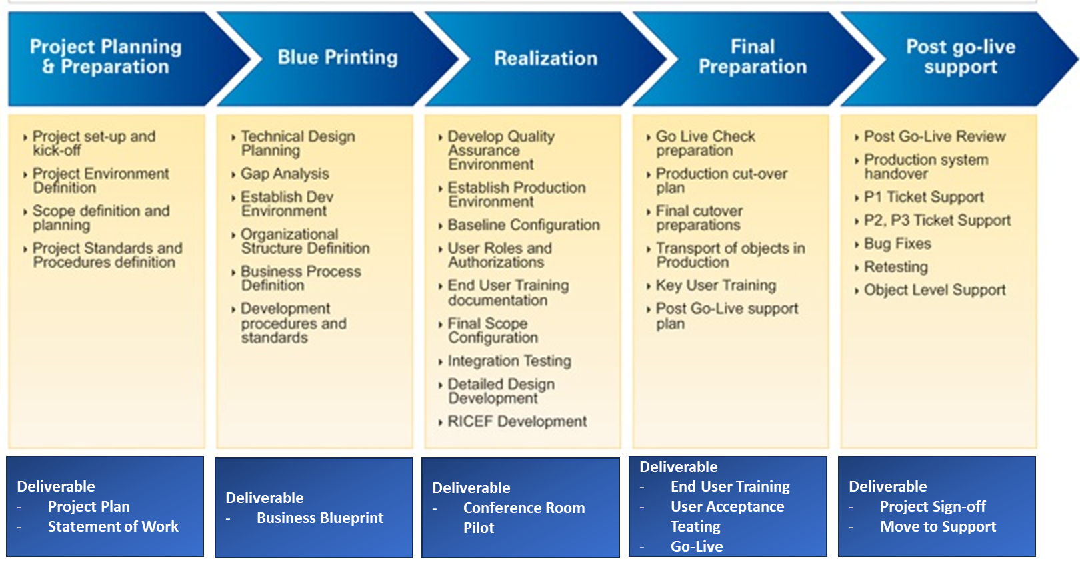
SAP Implementation Methodology
Deployed over 70,000 times

Slide 13




















Our evangelists for success

Slide 14
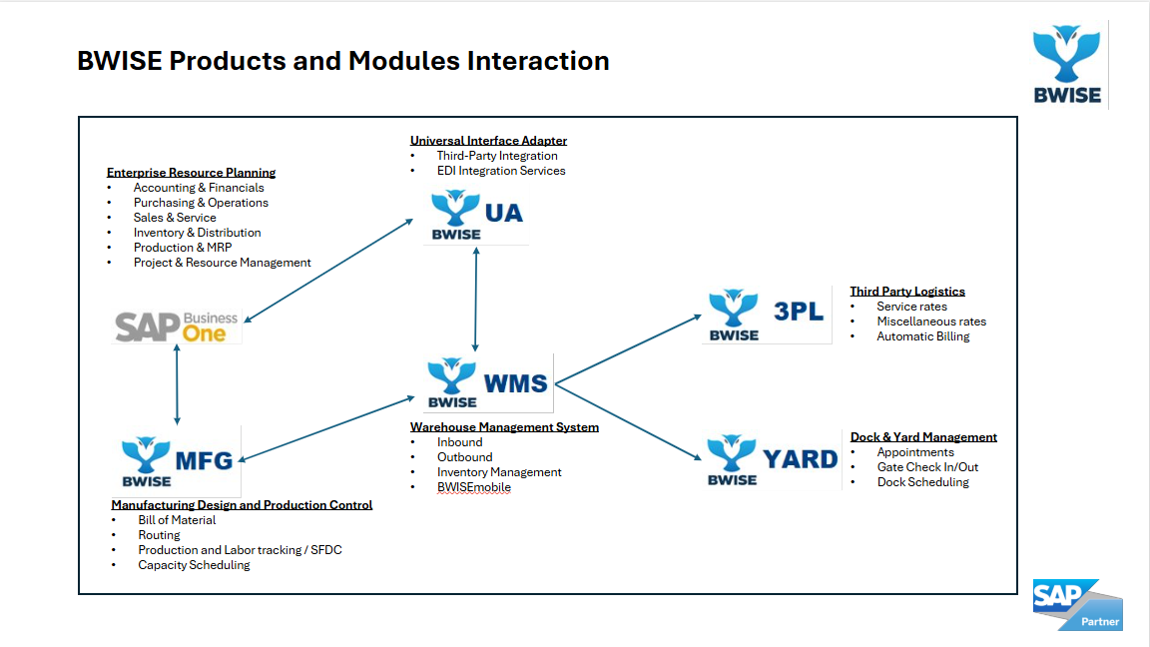
SAP Business One to WISE connector
B1 and S4 connection uses
SAP Service Layer
Cloud
Add Cristina’s slides

Slide 15
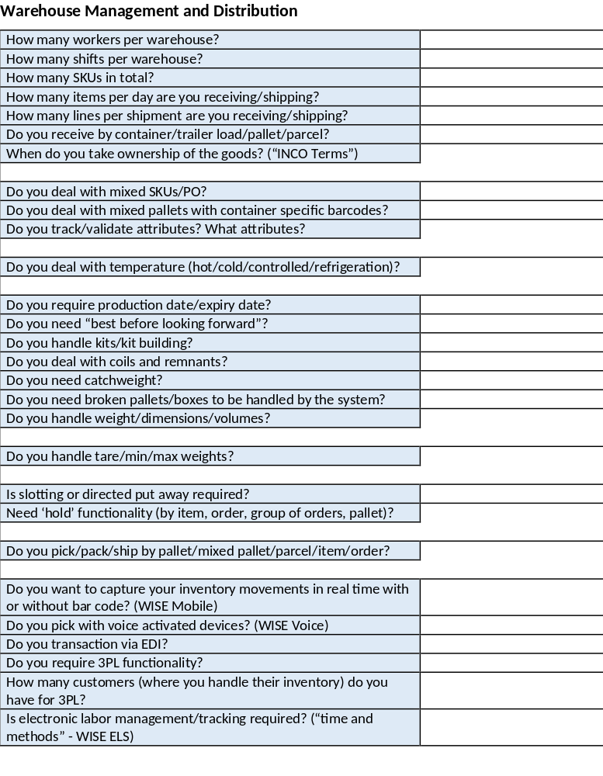
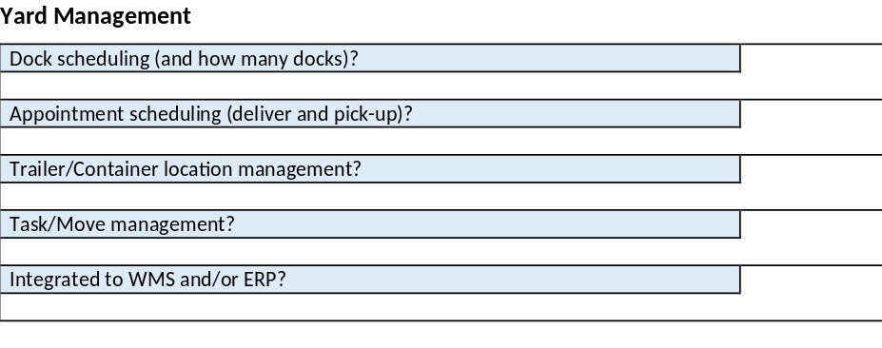
WISE – Demo Preparation – Discovery Questionnaire

Slide 16
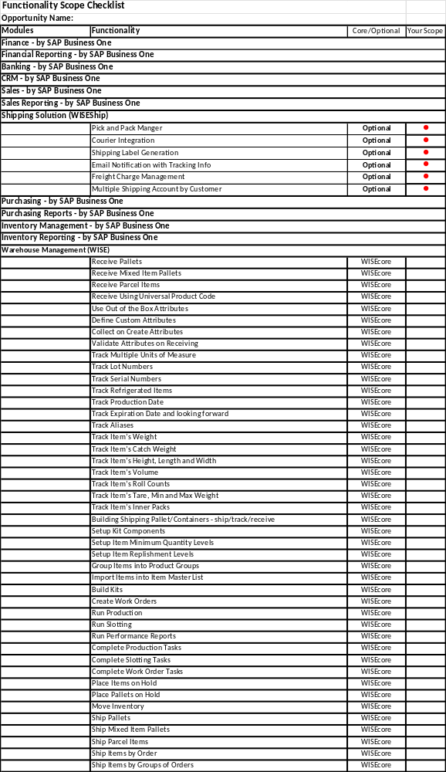
WISE – Quotation Process – Scoping – page 1

Slide 17
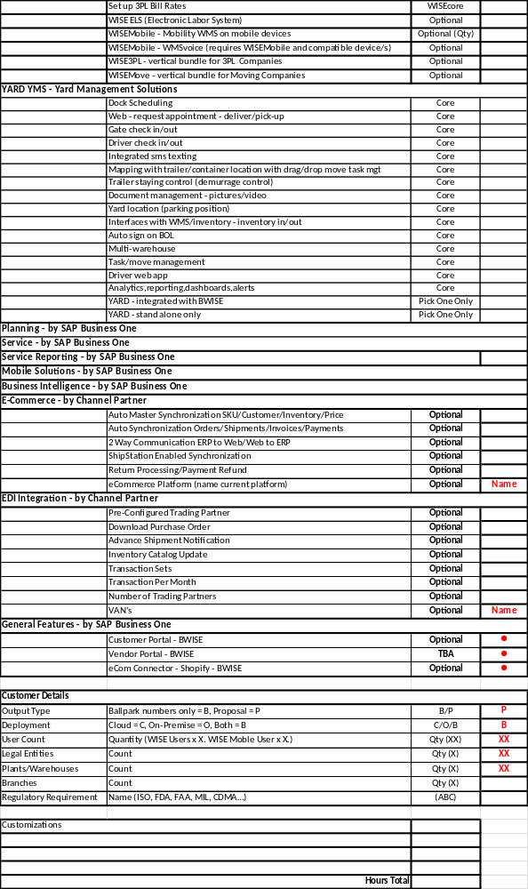
WISE – Quotation Process – Scoping – page 2

Slide 18
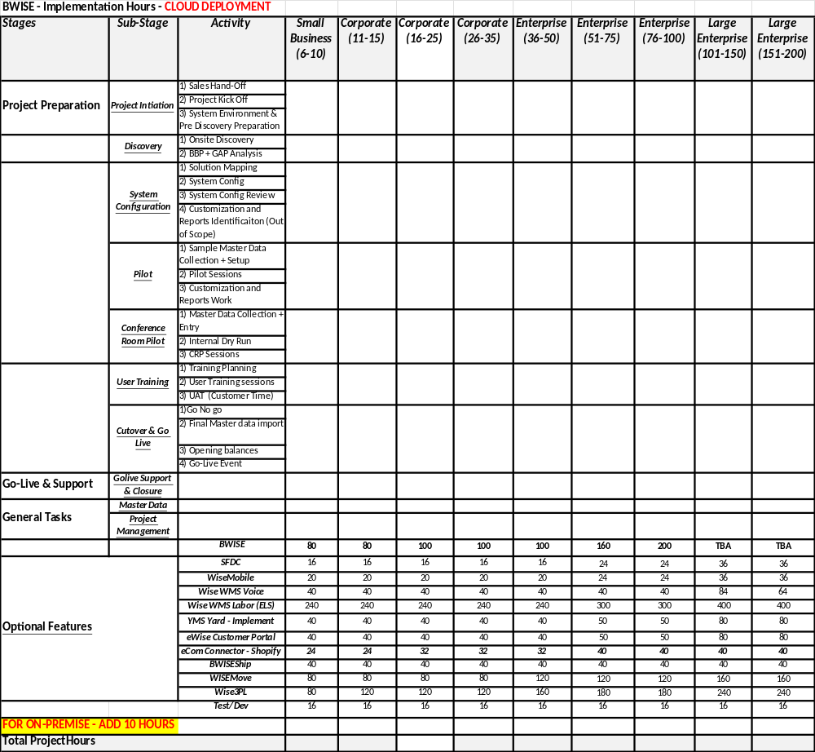
WISE – Quotation Process - Hours

Slide 19
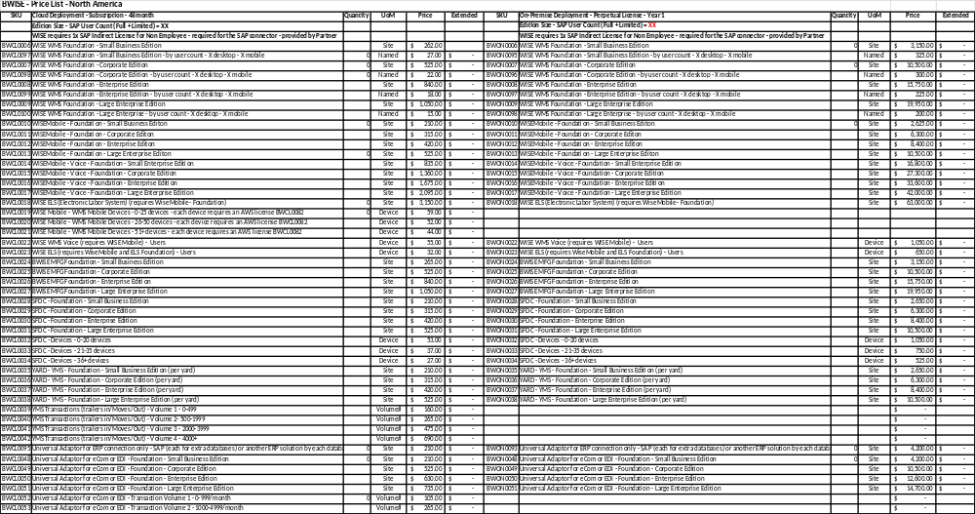
WISE – Quotation Process – Software Elements – page1

Slide 20
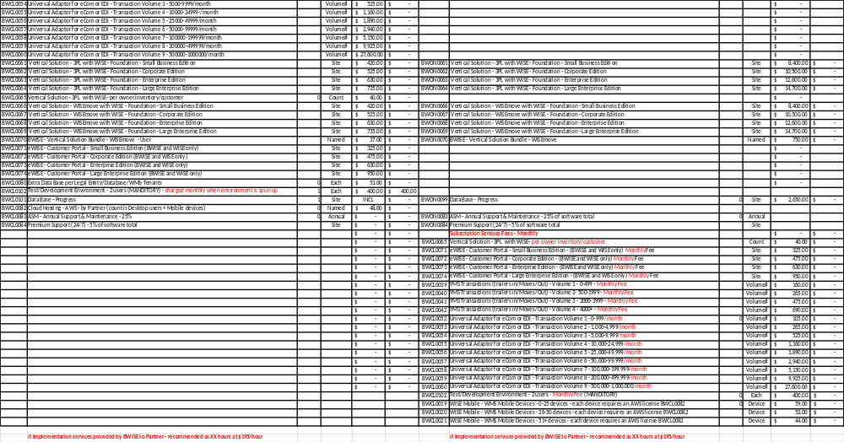
WISE – Quotation Process – Software Elements – page2

Slide 21
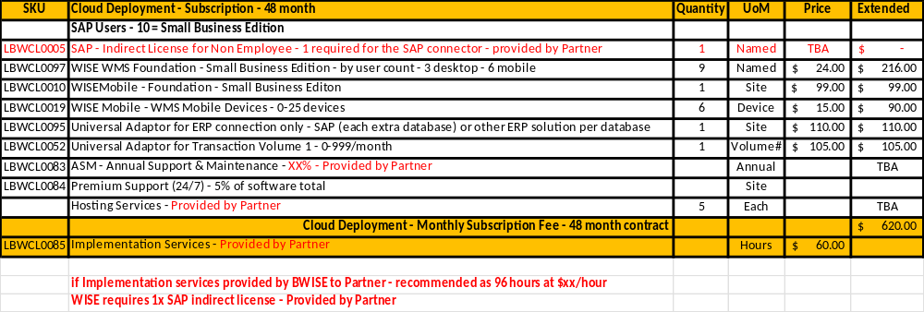
WISE – Quotation Process – Final Quote

Slide 22

Thank you.

